Slide 1

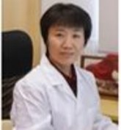


Fudan & Kenvue Pre-aging IIS Progress Update
AP Translational Science Team

Slide 2
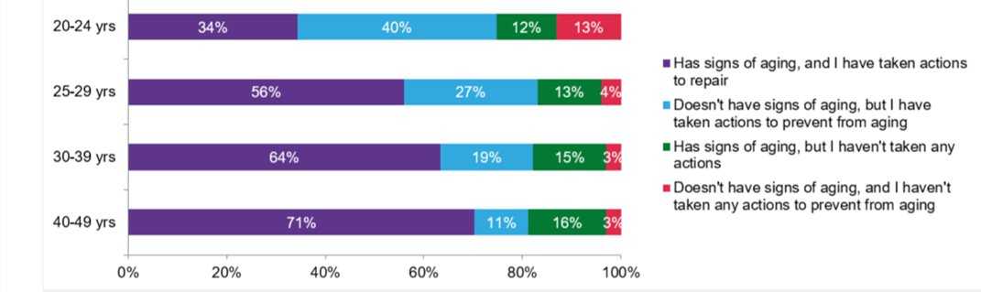
Why are we doing research for Pre-aging?
Consumer Insight & Business Opportunity: 75% consumer start to use anti-aging product before 25
Are there any emerging aging sign for 20+ yrs?
What is the science behind pre-aging?
How to translate with technical insights to consumers?
Notes:
Based on studies in 2020 in China and Japan from 18-35Y, women perceive preaging to be specific skin changes that start in the early 20s, such as dull skin, uneven skin tone and dryness, transient wrinkles, lack of skin firmness and slower recovery from acne marks
According to the study, 75% consumer start to use anti-aging product before 25.

Slide 3
Key Questions
What are the skin pre-aging signs & experience among Chinese female?
Skin phenotypes from clinical grading and instrument
Consumer Pre-aging Experience
Perceived age
How do the impact factors work on accelerated aging?
Life habits & environment
Skin metabolome and microbiome

Slide 4
AP Fundamental Preaging Study Design
Triggers
Intrinsic
Cell Activity
Lipid
Permanent Aging Signs
Mechanics
Components Metabolic
Function
Emerging aging Signs
Skin Structure
Barrier
Dermal Matrix Prod.
Fibroblasts
Stem Cells
Melanocytes
Keratinocytes
Extrinsic
Expression Line
Emerging Spots
Immunity
Protein
Microbial - Skin
Tone
Texture
Thickness
ED junction
Metabolism
Immunocytes
……
Impact to life
Other Perception
Self-perception
Study objective: Fundamental learning study to correlate biological changes with phenotypic/clinical changes and consumer perception to understand pre-aging
Consumer Oriented
Pre-clinical Targets & Solutions
Clinical Benefits & Measures
Consumer Oriented
Study design
Life habits QN
Tape Strips: Metabolomics biomarker
Swabs: Metagenomics
Clinical instrument:
Hydration, TEWL
Sebum, pH
Skin Texture
Wrinkles, Finelines
Elasticity
Translucency, Glossy
Clinical Image：
Full face image
Dynamic Facial Imaging
Dermatologist grading:
13 aging related attributes
Quality of Life QN
Age perception
Consumer Perception
Life habits
Metabolome & microbiome
Clinical Phonotype Measurements
Bioinformatics/Big Data Analysis
Consumer & Skin Insights
Notes:
Vital cell -> cell type and activity
FOSH-Business Question-current tech / next tech-hyperthesis
Microbiome workshop f/u
Pre-aging R&D ideation

Slide 5
Life habits Questionnaire
General:
Skin type: D/N/O, Fitzpatrick, Sensitive skin
BMI
Occupation (outdoor workers, office lady, housewife, student)
Intrinsic
Lifestyle (sleep quality, daily diet habit, smoking habit, alcohol intake, exercise habit, mental stress, skin care routine, make up habit and history, life rhythm)
Health condition (chronic skin disease, gut health, nutrition, internal medical conditions, sudden weight gain or loss, metabolism, pregnancy, give birth to a baby)
Extrinsic
Environment (Sun exposure, Humidity)
Pollution (Traffic, PM2.5)

Slide 6
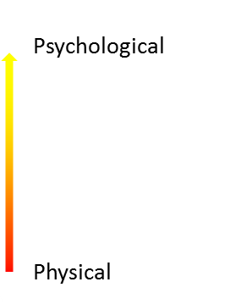
Quality of Life Questionnaire (Preaging Perception QN)
Develop
QoL References
Modify
ExC Focus Group Discussion
Validate
Historic studies
Pilot CLT results
In-depth interview
Rapid Z
Rapid V
Clinical fundamental research
THINC (concept)
Questionnaire (correlation survey)
The pyramid structure of the edition I QoL Questionnaire
Emotion
domain 4,5,6
Life impact
domain 3
Aging signs
domain 2
Emerging aging signs
domain 1
QoL Ref: DLQI (Dermatology Life Quality Index); Skindex-29, Skindex-16; AAQoL (Anti-aging QOL); BeautyQoL
Notes:
Reliability will be evaluated with internal consistency using Cronbach’s alpha.
Validity will be evaluated using known-groups validity, convergent validity and factor structure validity.
ExC FGD, survey, IDI

Slide 7
Timeline
Work Step | Time | DRI | Status
Working Model | 2020 July 5th | Fudan & Kenvue | Done
Proposal Final | 2020 July 30th | Fudan | Done
Agreement | 2020 July | Fudan & Kenvue | Done
Protocol Final | 2020 July 30th | Fudan & Kenvue | Done
IRB & Human Genetic Review | 2020 Aug to Oct | Fudan | Done
Clinical Fieldwork | 2020 Nov-Dec | Fudan | Done
Sample Analysis | 2021 Jan | Fudan | Done
Statistics summary | 1. Descriptive 2021 2. Hypothesis 2021 3. Exploration 2022 to 2023 | Fudan | On-going
Kenvue internal Study Result Sharing | 2023 Apr Tech Talk to RD 2023 Oct to FRD | Kenvue | Done
Conferences | 2023 AAD; 2024 AAD | Fudan & Kenvue | On-going
Publications | 2024 | Fudan & Kenvue | On-going

Slide 8

Methods & Material
What is the Objective Pre-aging phenotype based on chronological age?
Life Habit Impact
Linear regression to identify environmental factors that influence objective pre-aging features
164 healthy women
Shanghai
18-60yrs (G1-G6)
Correlation analysis between Objective aging phenotype
and chronological age to identify objective aging features
18-30yrs (G1-G2)
Correlation analysis between Objective aging phenotype and chronological age to identify objective Pre-aging features
vs
Group | Age | Number
G1 | 18-25 | 27
G2 | 26-30 | 25
G3 | 31-35 | 24
G4 | 36-40 | 33
G5 | 41-50 | 30
G6 | 51-60 | 25
What is the Consumer Subjective Pre-aging phenotype based on chronological age?
Life Habit Impact
Linear regression to identify environmental factors that influence subjective pre-aging phenotype
18-60yrs (G1-G6)
Correlation analysis between Subjective aging phenotype
and chronological age
to identify Subjective aging features
18-30yrs (G1-G2)
Correlation analysis between Subjective aging phenotype
and chronological age to identify Subjective preaging feature
vs
Objective aging phenotype
125 skin parameters
Clinical evaluation - 13 pre-aging related attributes
Instrument measurements
Identify The turning point of Clinical Phenotypic
Subjective aging phenotype Quality of Life QN
What Pre-aging phenotype accelerate Perceived age
except influence of chronological age?
Life Habit Impact
Linear regression to identify environmental factors that accelerate pre-aging features
Life Habit QN
18-60yrs (G1-G2)
Correlation analysis between Objective aging phenotype
and accelerated Aging rate (PA-CA)/CA
18-30yrs (G1-G2)
Correlation analysis between Objective aging phenotype
and accelerated Pre-aging rate (PA-CA)/CA
vs
Notes:
Introduction
As the global aging population increases, research of skin aging is gaining significant attention. Accurate identification of the characteristics of pre-aging is the key to achieving delayed aging (Anwar, et al., 2022). The aim of this study is to establish an assessment method for pre-aging in Chinese women, thus realising the possibility of precise anti-aging in the pre-aging phase.
Methods & Material
164 healthy subjects in Shanghai were recruited in a clinical study,
Separate them into 6 groups, each group has specific age range and 25-35 numbers of participants.
125 skin parameters were assessed for the aging assessment
including clinical evaluation, instrument measurements,
Correlation analysis was conducted between skin parameters with age of 18-60 and 18-30 separately. The intersection of these features was recognized as pre-aging features.
self-assessment questionnaires including life habits and skin pre-aging experience.
Subjects completed a questionnaire on the total time spend or frequency of various external factors such as cooking, outdoor, use of social media, smoking, diet and entertainment. Additionally, the questionnaire included current skin conditions and skin care habits.
Evaluation of exposome was conducted by one-way ANOVA, with clinical pre-aging skin features as dependent variable and lifestyles as independent variables.

Slide 9
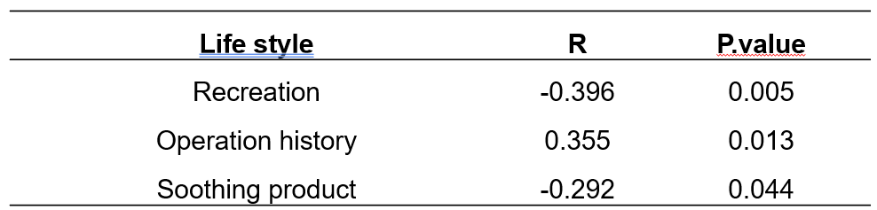
Result
What is the Objective Pre-aging phenotype based on chronological age?
Life Habit Impact
Lifestyle Factors Including Pollution, Use Of Skin Care And Social Media Are Important Exposomes Affecting Pre-aging，WIP
164 healthy women
Shanghai
18-60
18-30
Firmness, Smoothness, Elasticity,
ITA,
Scattering,
R2, R8, ALPHA,
R6, Pigmentation,
R7, L, K, Uneven skin tone, Glossiness, Translucency, b…
Photoaging,
Fine lines,
Sebum excretion
rate,
Wrinkle,
Wrinkle area
Group | Age | Number
G1 | 18-25 | 27
G2 | 26-30 | 25
G3 | 31-35 | 24
G4 | 36-40 | 33
G5 | 41-50 | 30
G6 | 51-60 | 25
Skin roughness via VC98
Rt, Ym, Y2, Rpm
WIP
What is the Consumer Subjective Pre-aging phenotype based on chronological age?
Life Habit Impact
WIP
18-60
18-30
Skin Dry
Skin Yellowish
Skin Sagging/Lack of Firmness
Wrinkles
Slow Acne Mark Recovery
Skin Dryness,Skin Roughness
Skin Dullness,Uneven Skin Tone
Skin Texture Change (Dry or Oily),
Slow Recovery After Sun Exposure
Expression Lines, Slow Acne Mark Recovery
Slow Metabolism Rate,Skin Yellowish/Pale Yellow
Lack of Radiance, Fine Lines Around Eyes
Neck Lines, Nasolabial Folds
Thin Skin, Lack of Skin Elasticity
Skin Sagging/Lack of Firmness
Wrinkles, Jawline Contour Blur
Q26 Lack of Fullness in Cheekbone Area
Objective aging phenotype
125 skin parameters
Clinical evaluation - 13 pre-aging related attributes
Instrument measurements
Identify The turning point of Clinical Phenotypic
Skin Dry
Skin Yellowish
Skin Sagging/Lack of Firmness
Wrinkles
Slow Acne Mark Recovery
WIP
pigmentation
pores
Subjective aging phenotype Quality of Life QN
What Pre-aging phenotype accelerate Perceived age
except influence of chronological age?
Life Habit Impact
WIP
18-30
Life Habit QN
18-60
18-30
44
Notes:
补文章的进展，，，
所有的环境因素可以用回归去做；
可以把18-30的全部因素都做了，然后放结果的时候放共有部分；；；不然你为什么要取交集呢？？？
我有一个问题，我有一个结局是年龄，连续性变量；有一些自变量，是分类变量。我可以用anova去看结局在不同分类当中是否显著。我也可以给分类变量赋值，然后做单因素回归，但自变量和结局关系是否显著；这两者有什么区别，得出来的结果一样吗？我其实想知道什么环境因素影响了年龄；
回答：
ANOVA（方差分析）和回归分析都是统计学中用于研究变量之间关系的方法，但它们适用于不同类型的数据，并且提供了不同类型的信息。
ANOVA（方差分析）：
用于比较三个或更多组之间的均值差异是否统计显著。
主要用于处理分类自变量（也称为因子），其中每个因子有两个或更多水平（组别）。
结果告诉我们至少有一组的均值与其它组存在显著差异，但不告诉我们具体哪些组之间存在差异。
对于后续的多重比较，需要用到如Tukey的HSD（Honestly Significant Difference）等方法来确定哪些组别之间有显著差异。
回归分析：
用于研究一个或多个自变量（连续变量或分类变量）如何影响一个连续的因变量。
当使用分类自变量时，需要将其编码（例如，使用哑变量编码）。
结果可以告诉我们自变量的每一水平与参考水平之间的差异。
回归分析还可以告诉我们自变量的每一单位变化如何影响因变量，即斜率（或回归系数）。
两者的区别：
ANOVA不适合揭示自变量的水平之间的关系，它只能告诉我们组间是否存在差异。
回归分析提供了更多的细节，可以揭示自变量的每个水平如何影响因变量。
在您的情况下：
如果您关心的是不同分类（如不同的环境因素）对年龄的影响是否存在显著差异，那么ANOVA是合适的。
如果您想知道每个特定分类水平与年龄的具体关系强度，回归分析更加适用。
结果是否一样：
ANOVA和回归分析在某些情况下可以得到相似的结论，例如，如果ANOVA显示有显著差异，那么回归分析中相应的分类变量的系数也很可能是显著的。
然而，回归分析可以提供更多关于如何以及在多大程度上自变量影响因变量的信息。
在您的研究中，如果您的目标是探索不同环境因素（分类变量）如何影响年龄（连续变量），您可以使用回归分析，将环境因素作为自变量，年龄作为因变量。您可以对环境因素进行编码，然后在模型中包括它们来查看每个因素的影响程度和统计显著性。这样，您不仅可以发现哪些因素显著，还可以了解它们各自对年龄的具体影响大小。
Introduction
As the global aging population increases, research of skin aging is gaining significant attention. Accurate identification of the characteristics of pre-aging is the key to achieving delayed aging (Anwar, et al., 2022). The aim of this study is to establish an assessment method for pre-aging in Chinese women, thus realising the possibility of precise anti-aging in the pre-aging phase.
Methods & Material
164 healthy subjects in Shanghai were recruited in a clinical study,
Separate them into 6 groups, each group has specific age range and 25-35 numbers of participants.
125 skin parameters were assessed for the aging assessment
including clinical evaluation, instrument measurements,
Correlation analysis was conducted between skin parameters with age of 18-60 and 18-30 separately. The intersection of these features was recognized as pre-aging features.
self-assessment questionnaires including life habits and skin pre-aging experience.
Subjects completed a questionnaire on the total time spend or frequency of various external factors such as cooking, outdoor, use of social media, smoking, diet and entertainment. Additionally, the questionnaire included current skin conditions and skin care habits.
Evaluation of exposome was conducted by one-way ANOVA, with clinical pre-aging skin features as dependent variable and lifestyles as independent variables.

Slide 10
Result
Exposome on wrinkle area | Pr(>F) | Exposome on sebum secretion rate | Pr(>F)
Smoking | 0.01132 | Social media | 0.01805
Entertainment | 0.01483 | Acne treatment | 0.02227
Outdoor time | 0.01809 | Cooking | 0.02677
 |  | Cleanser | 0.02913
1.用线性回归去做，找到影响初老（老化早期阶段的环境因素）；；；
What is the Objective Pre-aging phenotype based on chronological age?
Life Habit Impact
Lifestyle Factors Including Pollution, Use Of Skin Care And Social Media Are Important Exposomes Affecting Pre-aging，关注共有部分即可。
18-60
18-30
Firmness, Smoothness, Elasticity,
ITA,
Scattering,
R2, R8, ALPHA,
R6, Pigmentation,
R7, L, K, Uneven skin tone, Glossiness, Translucency, b…
Photoaging,
Fine lines,
Sebum excretion
rate,
Wrinkle,
Wrinkle area
Skin roughness via VC98
Rt, Ym, Y2, Rpm
Exposome on photoaging | Pr(>F) | Exposome on fine lines | Pr(>F) | Exposome on wrinkle | Pr(>F)
Cooking | 0.0072 | Facial lotion | 0.00184 | Social media | 0.00058
Outdoor time | 0.01081 | Social media | 0.00373 | Drinking tea | 0.00505
Social media | 0.0188 | Frequency of exposure to cooking fumes | 0.03589 | Facial cream | 0.0137
Cleanser | 0.02247 |  |  | Cooking | 0.02821
Essences | 0.02708 |  |  | Electronic equipment | 0.02865
Acne treatment | 0.02788 |  |  | Facial lotion | 0.0289
Eye cream | 0.04601 |  |  | High-carbohydrate snacks or desserts | 0.03597
Table 25 Significant life habits correlated with clinical pre-aging skin features
Notes:
补文章的进展，，，
选择年龄段的问题；；；；
明确您的研究目的是关键。如果您的目标是理解初老特征与成年早期的环境因素之间的关系，那么可能倾向于选择18-30岁的数据。
如果您希望探索整个成年期的环境因素如何共同作用影响初老特征，那么使用18-60岁的数据可能更合适。
所有的环境因素可以用回归去做；
可以把18-30的全部因素都做了，然后放结果的时候放共有部分；；；不然你为什么要取交集呢？？？
我有一个问题，我有一个结局是年龄，连续性变量；有一些自变量，是分类变量。我可以用anova去看结局在不同分类当中是否显著。我也可以给分类变量赋值，然后做单因素回归，但自变量和结局关系是否显著；这两者有什么区别，得出来的结果一样吗？我其实想知道什么环境因素影响了年龄；
回答：
ANOVA（方差分析）和回归分析都是统计学中用于研究变量之间关系的方法，但它们适用于不同类型的数据，并且提供了不同类型的信息。
ANOVA（方差分析）：
用于比较三个或更多组之间的均值差异是否统计显著。
主要用于处理分类自变量（也称为因子），其中每个因子有两个或更多水平（组别）。
结果告诉我们至少有一组的均值与其它组存在显著差异，但不告诉我们具体哪些组之间存在差异。
对于后续的多重比较，需要用到如Tukey的HSD（Honestly Significant Difference）等方法来确定哪些组别之间有显著差异。
回归分析：
用于研究一个或多个自变量（连续变量或分类变量）如何影响一个连续的因变量。
当使用分类自变量时，需要将其编码（例如，使用哑变量编码）。
结果可以告诉我们自变量的每一水平与参考水平之间的差异。
回归分析还可以告诉我们自变量的每一单位变化如何影响因变量，即斜率（或回归系数）。
两者的区别：
ANOVA不适合揭示自变量的水平之间的关系，它只能告诉我们组间是否存在差异。
回归分析提供了更多的细节，可以揭示自变量的每个水平如何影响因变量。
在您的情况下：
如果您关心的是不同分类（如不同的环境因素）对年龄的影响是否存在显著差异，那么ANOVA是合适的。
如果您想知道每个特定分类水平与年龄的具体关系强度，回归分析更加适用。
结果是否一样：
ANOVA和回归分析在某些情况下可以得到相似的结论，例如，如果ANOVA显示有显著差异，那么回归分析中相应的分类变量的系数也很可能是显著的。
然而，回归分析可以提供更多关于如何以及在多大程度上自变量影响因变量的信息。
在您的研究中，如果您的目标是探索不同环境因素（分类变量）如何影响年龄（连续变量），您可以使用回归分析，将环境因素作为自变量，年龄作为因变量。您可以对环境因素进行编码，然后在模型中包括它们来查看每个因素的影响程度和统计显著性。这样，您不仅可以发现哪些因素显著，还可以了解它们各自对年龄的具体影响大小。
Introduction
As the global aging population increases, research of skin aging is gaining significant attention. Accurate identification of the characteristics of pre-aging is the key to achieving delayed aging (Anwar, et al., 2022). The aim of this study is to establish an assessment method for pre-aging in Chinese women, thus realising the possibility of precise anti-aging in the pre-aging phase.
Methods & Material
164 healthy subjects in Shanghai were recruited in a clinical study,
Separate them into 6 groups, each group has specific age range and 25-35 numbers of participants.
125 skin parameters were assessed for the aging assessment
including clinical evaluation, instrument measurements,
Correlation analysis was conducted between skin parameters with age of 18-60 and 18-30 separately. The intersection of these features was recognized as pre-aging features.
self-assessment questionnaires including life habits and skin pre-aging experience.
Subjects completed a questionnaire on the total time spend or frequency of various external factors such as cooking, outdoor, use of social media, smoking, diet and entertainment. Additionally, the questionnaire included current skin conditions and skin care habits.
Evaluation of exposome was conducted by one-way ANOVA, with clinical pre-aging skin features as dependent variable and lifestyles as independent variables.

Slide 11
Result
1.消费者主观评估找到环境因素，环境因素如何影响他们？
18-60
20多个主观评估
Skin Dryness,Skin Roughness
Skin Dullness,Uneven Skin Tone
Skin Texture Change (Dry or Oily),
Slow Recovery After Sun Exposure
Expression Lines, Slow Acne Mark Recovery
Slow Metabolism Rate,Skin Yellowish/Pale Yellow
Lack of Radiance, Fine Lines Around Eyes
Neck Lines, Nasolabial Folds
Thin Skin, Lack of Skin Elasticity
Skin Sagging/Lack of Firmness
Wrinkles, Jawline Contour Blur
Q26 Lack of Fullness in Cheekbone Area
WIP
What is the Consumer Subjective Pre-aging phenotype based on chronological age?
Life Habit Impact
关注共有部分；
完成
18-60
18-30
Skin Dry
Skin Yellowish
Skin Sagging/Lack of Firmness
Wrinkles
Slow Acne Mark Recovery
18-30
Skin Dryness,Skin Roughness
Skin Dullness,Uneven Skin Tone
Skin Texture Change (Dry or Oily),
Slow Recovery After Sun Exposure
Expression Lines, Slow Acne Mark Recovery
Slow Metabolism Rate,Skin Yellowish/Pale Yellow
Lack of Radiance, Fine Lines Around Eyes
Neck Lines, Nasolabial Folds
Thin Skin, Lack of Skin Elasticity
Skin Sagging/Lack of Firmness
Wrinkles, Jawline Contour Blur
Q26 Lack of Fullness in Cheekbone Area
Q1 Skin Dryness
Q14 Skin Yellowish/Pale Yellow
Q17 Fine Lines Around Eyes
Q22 Lack of Skin Elasticity
Q23 Skin Sagging/Lack of Firmness
Q26 Lack of Fullness in Cheekbone Area
Skin Dry
Skin Yellowish
Skin Sagging/Lack of Firmness
Wrinkles
Slow Acne Mark Recovery
Notes:
补文章的进展，，，
觉得生物学上有道理，而且比较重要；；
18-60～表型和老化速率的关系？？？
Feature Spearman Correlation with Age p-value Q1 Skin Dryness 0.328734804 1.72565E-05 Q2 Skin Roughness 0.2913598 0.000153619 Q3 Skin Dullness 0.304340423 7.43089E-05 Q4 Uneven Skin Tone 0.209709561 0.007037025 Q5 Skin Texture Change (Dry or Oily) 0.264608782 0.000617146 Q6 Slow Recovery After Sun Exposure 0.193594529 0.012998853 Q7 Expression Lines 0.28827822 0.000181611 Q9 Slow Acne Mark Recovery -0.193325663 0.013127756 Q10 Slow Metabolism Rate 0.209732462 0.00703067 Q14 Skin Yellowish/Pale Yellow 0.256741956 0.000904834 Q16 Lack of Radiance 0.186802229 0.01661767 Q17 Fine Lines Around Eyes 0.417729532 2.61846E-08 Q18 Neck Lines 0.293287971 0.000138209 Q19 Nasolabial Folds 0.415010079 3.28911E-08 Q20 Thin Skin 0.237038971 0.002242836 Q22 Lack of Skin Elasticity 0.404040027 8.08635E-08 Q23 Skin Sagging/Lack of Firmness 0.421421704 1.91505E-08 Q24 Wrinkles 0.521861359 7.73373E-13 Q25 Jawline Contour Blur 0.256523988 0.000914326 Q26 Lack of Fullness in Cheekbone Area 0.405228396 7.34693E-08
所有的环境因素可以用回归去做；
可以把18-30的全部因素都做了，然后放结果的时候放共有部分；；；不然你为什么要取交集呢？？？
我有一个问题，我有一个结局是年龄，连续性变量；有一些自变量，是分类变量。我可以用anova去看结局在不同分类当中是否显著。我也可以给分类变量赋值，然后做单因素回归，但自变量和结局关系是否显著；这两者有什么区别，得出来的结果一样吗？我其实想知道什么环境因素影响了年龄；
回答：
ANOVA（方差分析）和回归分析都是统计学中用于研究变量之间关系的方法，但它们适用于不同类型的数据，并且提供了不同类型的信息。
ANOVA（方差分析）：
用于比较三个或更多组之间的均值差异是否统计显著。
主要用于处理分类自变量（也称为因子），其中每个因子有两个或更多水平（组别）。
结果告诉我们至少有一组的均值与其它组存在显著差异，但不告诉我们具体哪些组之间存在差异。
对于后续的多重比较，需要用到如Tukey的HSD（Honestly Significant Difference）等方法来确定哪些组别之间有显著差异。
回归分析：
用于研究一个或多个自变量（连续变量或分类变量）如何影响一个连续的因变量。
当使用分类自变量时，需要将其编码（例如，使用哑变量编码）。
结果可以告诉我们自变量的每一水平与参考水平之间的差异。
回归分析还可以告诉我们自变量的每一单位变化如何影响因变量，即斜率（或回归系数）。
两者的区别：
ANOVA不适合揭示自变量的水平之间的关系，它只能告诉我们组间是否存在差异。
回归分析提供了更多的细节，可以揭示自变量的每个水平如何影响因变量。
在您的情况下：
如果您关心的是不同分类（如不同的环境因素）对年龄的影响是否存在显著差异，那么ANOVA是合适的。
如果您想知道每个特定分类水平与年龄的具体关系强度，回归分析更加适用。
结果是否一样：
ANOVA和回归分析在某些情况下可以得到相似的结论，例如，如果ANOVA显示有显著差异，那么回归分析中相应的分类变量的系数也很可能是显著的。
然而，回归分析可以提供更多关于如何以及在多大程度上自变量影响因变量的信息。
在您的研究中，如果您的目标是探索不同环境因素（分类变量）如何影响年龄（连续变量），您可以使用回归分析，将环境因素作为自变量，年龄作为因变量。您可以对环境因素进行编码，然后在模型中包括它们来查看每个因素的影响程度和统计显著性。这样，您不仅可以发现哪些因素显著，还可以了解它们各自对年龄的具体影响大小。
Introduction
As the global aging population increases, research of skin aging is gaining significant attention. Accurate identification of the characteristics of pre-aging is the key to achieving delayed aging (Anwar, et al., 2022). The aim of this study is to establish an assessment method for pre-aging in Chinese women, thus realising the possibility of precise anti-aging in the pre-aging phase.
Methods & Material
164 healthy subjects in Shanghai were recruited in a clinical study,
Separate them into 6 groups, each group has specific age range and 25-35 numbers of participants.
125 skin parameters were assessed for the aging assessment
including clinical evaluation, instrument measurements,
Correlation analysis was conducted between skin parameters with age of 18-60 and 18-30 separately. The intersection of these features was recognized as pre-aging features.
self-assessment questionnaires including life habits and skin pre-aging experience.
Subjects completed a questionnaire on the total time spend or frequency of various external factors such as cooking, outdoor, use of social media, smoking, diet and entertainment. Additionally, the questionnaire included current skin conditions and skin care habits.
Evaluation of exposome was conducted by one-way ANOVA, with clinical pre-aging skin features as dependent variable and lifestyles as independent variables.

Slide 12
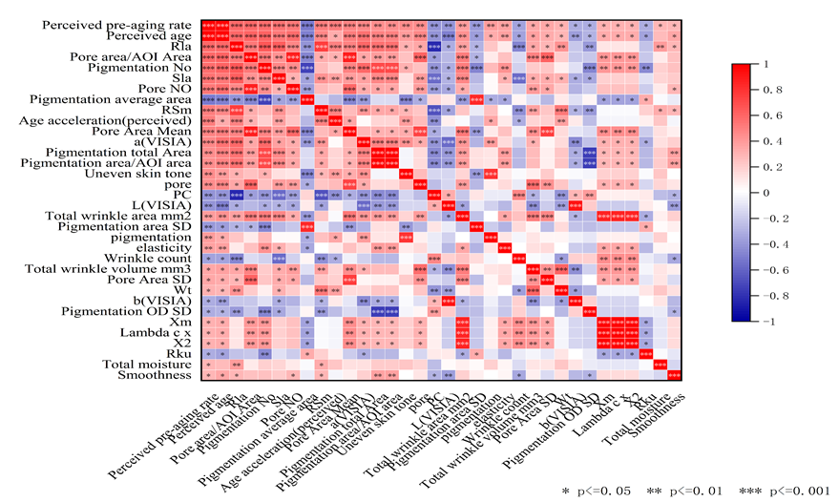
Result
1.用线性回归去做，找到环境因素；；；
18-30
WIP
pigmentation
pores
What Pre-aging phenotype accelerate Perceived age
except influence of chronological age?
Life Habit Impact
关注共有部分
18-30
生物学速率和其他表型的关系；
环境因素如何影响生物学速率？
18-60
18-30
Notes:
补文章的进展，，，
所有的环境因素可以用回归去做；
可以把18-30的全部因素都做了，然后放结果的时候放共有部分；；；不然你为什么要取交集呢？？？
我有一个问题，我有一个结局是年龄，连续性变量；有一些自变量，是分类变量。我可以用anova去看结局在不同分类当中是否显著。我也可以给分类变量赋值，然后做单因素回归，但自变量和结局关系是否显著；这两者有什么区别，得出来的结果一样吗？我其实想知道什么环境因素影响了年龄；
回答：
ANOVA（方差分析）和回归分析都是统计学中用于研究变量之间关系的方法，但它们适用于不同类型的数据，并且提供了不同类型的信息。
ANOVA（方差分析）：
用于比较三个或更多组之间的均值差异是否统计显著。
主要用于处理分类自变量（也称为因子），其中每个因子有两个或更多水平（组别）。
结果告诉我们至少有一组的均值与其它组存在显著差异，但不告诉我们具体哪些组之间存在差异。
对于后续的多重比较，需要用到如Tukey的HSD（Honestly Significant Difference）等方法来确定哪些组别之间有显著差异。
回归分析：
用于研究一个或多个自变量（连续变量或分类变量）如何影响一个连续的因变量。
当使用分类自变量时，需要将其编码（例如，使用哑变量编码）。
结果可以告诉我们自变量的每一水平与参考水平之间的差异。
回归分析还可以告诉我们自变量的每一单位变化如何影响因变量，即斜率（或回归系数）。
两者的区别：
ANOVA不适合揭示自变量的水平之间的关系，它只能告诉我们组间是否存在差异。
回归分析提供了更多的细节，可以揭示自变量的每个水平如何影响因变量。
在您的情况下：
如果您关心的是不同分类（如不同的环境因素）对年龄的影响是否存在显著差异，那么ANOVA是合适的。
如果您想知道每个特定分类水平与年龄的具体关系强度，回归分析更加适用。
结果是否一样：
ANOVA和回归分析在某些情况下可以得到相似的结论，例如，如果ANOVA显示有显著差异，那么回归分析中相应的分类变量的系数也很可能是显著的。
然而，回归分析可以提供更多关于如何以及在多大程度上自变量影响因变量的信息。
在您的研究中，如果您的目标是探索不同环境因素（分类变量）如何影响年龄（连续变量），您可以使用回归分析，将环境因素作为自变量，年龄作为因变量。您可以对环境因素进行编码，然后在模型中包括它们来查看每个因素的影响程度和统计显著性。这样，您不仅可以发现哪些因素显著，还可以了解它们各自对年龄的具体影响大小。
Introduction
As the global aging population increases, research of skin aging is gaining significant attention. Accurate identification of the characteristics of pre-aging is the key to achieving delayed aging (Anwar, et al., 2022). The aim of this study is to establish an assessment method for pre-aging in Chinese women, thus realising the possibility of precise anti-aging in the pre-aging phase.
Methods & Material
164 healthy subjects in Shanghai were recruited in a clinical study,
Separate them into 6 groups, each group has specific age range and 25-35 numbers of participants.
125 skin parameters were assessed for the aging assessment
including clinical evaluation, instrument measurements,
Correlation analysis was conducted between skin parameters with age of 18-60 and 18-30 separately. The intersection of these features was recognized as pre-aging features.
self-assessment questionnaires including life habits and skin pre-aging experience.
Subjects completed a questionnaire on the total time spend or frequency of various external factors such as cooking, outdoor, use of social media, smoking, diet and entertainment. Additionally, the questionnaire included current skin conditions and skin care habits.
Evaluation of exposome was conducted by one-way ANOVA, with clinical pre-aging skin features as dependent variable and lifestyles as independent variables.

Slide 13
The turning point of Clinical Phenotype for Chinese women's pre-aging and aging group
Algorithm name: DE-SWAN¹
Result: Thirty-one years of age showed the most changes in pre-aging phenotypic differences. The number of aging phenotypes increases dramatically between the ages of 24 and 31, indicating that the skin is undergoing rapid Pre-aging.
The skin phenotype data showed that the turning point of pre-aging was 31 years old and the turning point of aging was 44 years old.
The subsequent analysis used 30 years old as the dividing point of early aging
44
1 Lehallier B, Gate D, Schaum N, Nanasi T, Lee SE, Yousef H, Moran Losada P, Berdnik D, Keller A, Verghese J, Sathyan S, Franceschi C, Milman S, Barzilai N, Wyss-Coray T. Undulating changes in human plasma proteome profiles across the lifespan. Nat Med. 2019 Dec;25(12):1843-1850. doi: 10.1038/s41591-019-0673-2. Epub 2019 Dec 5. PMID: 31806903; PMCID: PMC7062043.
Notes:
31岁和44岁显示出最多的衰老表型差异变化。衰老表型的数量在24岁到31岁之间急剧增加，这表明皮肤正在经历快速衰老。
Clinical evaluation: wrinkle, firmness, fine lines, photoaging
Primos: wrinkle area,Rt,Ym,Y2,Rpm
Primos:Used to evaluate skin texture related parameters(Cheek roughness, pore and wrinkle parameters);
Ra,Sa:skin roughness
Only shown in 18-30 :the other 4 are :Rt Ym Y2 Rpm, it represents the skin roughness.
The data from visia is against common sense, so we eliminate the data measured by visia.(47 change to 41, 14 change to 9 characteristics).

Slide 14
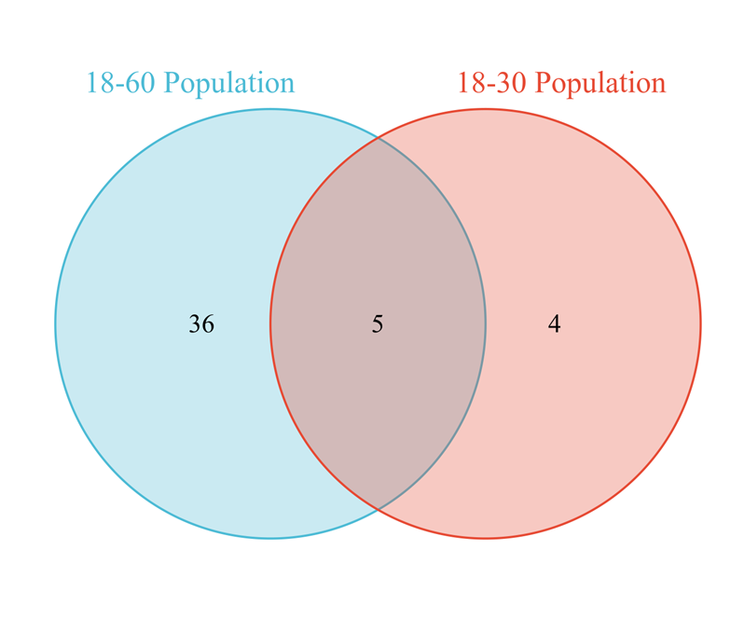
Photoaging, fine lines, sebum excretion rate, wrinkle and wrinkle area are significant features of pre-aging
Objective Pre-aging phenotype based on chronological age
Skin characteristics in 18-60 age group
Skin characteristics in 18-30 age group (pre-aging)
Skin characteristics in the intersection of these groups
Firmness, Smoothness, Elasticity,
ITA,
Scattering,
R2, R8, ALPHA,
R6, Pigmentation,
R7, L, K, Uneven skin tone, Glossiness, Translucency, b…
Photoaging,
Fine lines,
Sebum excretion
rate,
Wrinkle,
Wrinkle area
Rt, Ym, Y2, Rpm
In total, there were 5 significant characteristics in the two different age groups, which we refer to as pre-aging characteristics. In particular, photoaging (r=0.43,p=0.002), fine lines(r= 0.34,p=0.019) , sebum excretion rate(r= -0.33,p=0.023) , wrinkle(r=0.32 ,p=0.028 ) and wrinkle area (r=0.29,p=0.048) were significant indicators of pre-aging.
We found 41 skin characteristics (TOP 20 sorted by p value have shown here) in the 18-60 age group, with wrinkle (r=0.86,p<0.001), firmness (r=0.84,p<0.001) and fine lines (r=0.84,p<0.001) being the three most significant aging characteristics.
We recognized 9 skin characteristics out significantly associated with age in the 18-30 age group. It included photoaging, fine lines, wrinkle, wrinkle area, Rt, Ym, Y2, Rpm and sebum excretion rate.
Notes:
Clinical evaluation: wrinkle, firmness, fine lines, photoaging
Primos: wrinkle area,Rt,Ym,Y2,Rpm
Primos:Used to evaluate skin texture related parameters(Cheek roughness, pore and wrinkle parameters);
Ra,Sa:skin roughness
Only shown in 18-30 :the other 4 are :Rt Ym Y2 Rpm, it represents the skin roughness.
The data from visia is against common sense, so we eliminate the data measured by visia.(47 change to 41, 14 change to 9 characteristics).

Slide 15
Lifestyle Factors Including Pollution, Use Of Skin Care And Social Media Are Important Exposomes Affecting Pre-aging
Significant life habits correlated with clinical pre-aging skin features
Exposome on photoaging | Pr(>F) | Exposome on fine lines | Pr(>F) | Exposome on wrinkle | Pr(>F) | Exposome on wrinkle area | Pr(>F) | Exposome on sebum secretion rate | Pr(>F)
Cooking | 0.00720 | Facial lotion | 0.00184 | Social media | 0.00058 | Smoking | 0.01132 | Social media | 0.01805
Outdoor time | 0.01081 | Social media | 0.00373 | Drinking tea | 0.00505 | Entertainment | 0.01483 | Acne treatment | 0.02227
Social media | 0.01880 | Frequency of exposure to cooking fumes | 0.03589 | Facial cream | 0.01370 | Outdoor time | 0.01809 | Cooking | 0.02677
Cleanser | 0.02247 |  |  | Cooking | 0.02821 |  |  | Cleanser | 0.02913
Essences | 0.02708 |  |  | Electronic equipment | 0.02865
Acne treatment | 0.02788 |  |  | Facial lotion | 0.02890
Eye cream | 0.04601 |  |  | High-carbohydrate snacks or desserts | 0.03597
Life Habit Categories
Pollution
Skin care
Social media
Outdoor
Diet
Exposure to pollutants in cooking fumes and smoking is correlated with all pre-aging signs and sebum secretion.
Use of skin care and total time spend on social media are correlated with all pre-aging signs and sebum secretion, except for wrinkle area.
Time spend outdoors is correlated with photoaging and wrinkle area.
Diet including tea and desserts is correlated with wrinkle.
Notes:
面部乳液：facial lotion;

Slide 16
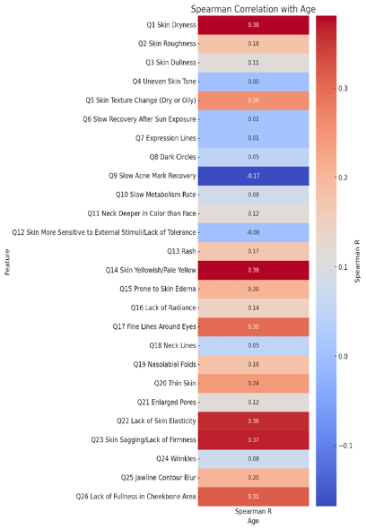
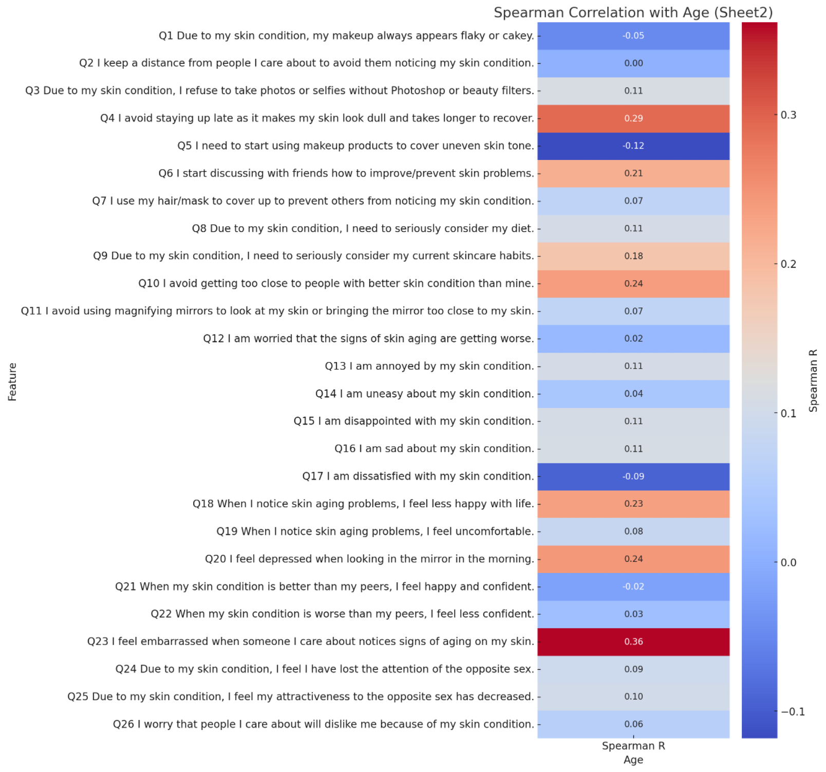
Subjective Pre-aging phenotype based on chronological age (18-30yrs)
Notes:
Q1 Skin Dryness (R=0.38) suggests that the perception of skin dryness increases with age. Dryness of the skin could be linked to changes in the stratum corneum, the outermost layer of the skin, which can become less efficient at retaining moisture as part of the intrinsic aging process. Q14 Skin Yellowish/Pale Yellow (R=0.38) indicate a change in skin color towards yellowish/pale yellow tones with advancing age. This could be associated with the accumulation of advanced glycation end-products (AGEs) in the skin, which can occur over time due to prolonged exposure to sugars. Q23 Skin Sagging/Lack of Firmness (R=0.37) and Q24 Wrinkles (R=0.38) have a similar correlation coefficient and are classic markers of aging skin, characterized by a decrease in collagen and elastin fibers, which are critical for maintaining skin's firmness and elasticity. Q23 I feel embarrassed when someone I care about notices signs of aging on my skin (R=0.38): This strong positive correlation suggests that concerns about visible aging signs become more pronounced as individuals get older, potentially impacting their social interactions and self-esteem. (Figure S1)

Slide 17
Fundamental learnings on the skin phenotypes and perception of pre-aging in Chinese female
Yanyun Ma¹, Li Ma², Yueying Fu², Cecilia Li², Weilin Pu¹, Yizhou Liu¹
1. School of Life Sciences, Fudan University, Shanghai, China
2. Johnson & Johnson China Ltd., Shanghai, China
Disclosures: This work was sponsored by Johnson & Johnson Pte Ltd.

Slide 18
Introduction, Methods & Material
Introduction
As the global aging population increases, research of skin aging is gaining significant attention. Accurate identification of the characteristics of pre-aging is the key to achieving delayed aging (Anwar, et al., 2022). The aim of this study is to establish an assessment method for pre-aging in Chinese women, thus realising the possibility of precise anti-aging in the pre-aging phase.
Methods & Material
164 healthy subjects in Shanghai were recruited in a clinical study, 125 skin parameters were assessed for the aging assessment including clinical evaluation, instrument measurements, and self-assessment questionnaires including life habits and skin pre-aging experience. Correlation analysis was conducted between skin parameters with age of 18-60 and 18-30 separately. The intersection of these features was recognized as pre-aging features.
Subjects completed a questionnaire on the total time spend or frequency of various external factors such as cooking, outdoor, use of social media, smoking, diet and entertainment. Additionally, the questionnaire included current skin conditions and skin care habits. Evaluation of exposome was conducted by one-way ANOVA, with clinical pre-aging skin features as dependent variable and lifestyles as independent variables.
164 healthy women
Shanghai
Group | Age | Number
G1 | 18-25 | 27
G2 | 26-30 | 25
G3 | 31-35 | 24
G4 | 36-40 | 33
G5 | 41-50 | 30
G6 | 51-60 | 25
125 skin parameters
Clinical evaluation
Instrument measurements
Self-assessment questionnaires
Life habits
Skin pre-aging experience
18-60
(G1-G6)
vs
18-30
(G1-G2)
Correlation analysis to identify pre-aging skin features
Lifestyle Impact
One-way ANOVA to identify environmental factors influencing pre-aging
Anwar, et al. JEADV Clinical Practice, 2022

Slide 19
Pre-aging Features Include Photoaging, Fine Lines, Sebum Excretion Rate, Wrinkle, Wrinkle Area and Roughness
Figure 1. Skin characteristics in 18-60 age group
Figure 2. Skin characteristics in 18-30 pre-aging group
Figure 3. Skin characteristics in the intersection of 18-60 and 18-30 age groups
Firmness, Smoothness, Elasticity,
Cutometer (R2, R6, R7, R8),
ITA, L*, b*
Scattering,
Pigmentation,
Uneven skin tone, Glossiness, Translucency, ALPHA, K …
Photoaging,
Fine lines,
Sebum excretion
rate,
Wrinkle,
Wrinkle area
Skin Roughness by PRIMOS (Rt, Ym, Y2, Rpm)
We found 41 skin characteristics (TOP 20 sorted by p value in figure 1) in the 18-60 age group, with wrinkle (r=0.86), firmness (r=0.84) and fine lines (r=0.84) being the three most significant aging characteristics.
We identified 9 skin characteristics were significantly associated with 18-30 pre-aging group, including photoaging, fine lines, wrinkle, wrinkle area, Skin roughness (Rt, Ym, Y2, Rpm) and sebum excretion rate.
In total, there were 5 overlapping characteristics in the two different age groups, including photoaging (r=0.43), fine lines (r= 0.34), sebum excretion rate (r= -0.33), wrinkle (r=0.32) and wrinkle area (r=0.29) were significant indicators of pre-aging. Skin roughness (Rt, Ym, Y2 and Rpm) were found only in the pre-aging group. All these 9 characteristics are refer to as pre-aging characteristics.

Slide 20
Lifestyle Factors Including Pollution, Use Of Skin Care And Social Media Are Important Exposomes Affecting Pre-aging
Significant life habits correlated with clinical pre-aging skin features
Exposome on photoaging | Pr(>F) | Exposome on fine lines | Pr(>F) | Exposome on wrinkle | Pr(>F) | Exposome on wrinkle area | Pr(>F) | Exposome on sebum secretion rate | Pr(>F)
Cooking | 0.00720 | Facial lotion | 0.00184 | Social media | 0.00058 | Smoking | 0.01132 | Social media | 0.01805
Outdoor time | 0.01081 | Social media | 0.00373 | Drinking tea | 0.00505 | Entertainment | 0.01483 | Acne treatment | 0.02227
Social media | 0.01880 | Frequency of exposure to cooking fumes | 0.03589 | Facial cream | 0.01370 | Outdoor time | 0.01809 | Cooking | 0.02677
Cleanser | 0.02247 |  |  | Cooking | 0.02821 |  |  | Cleanser | 0.02913
Essences | 0.02708 |  |  | Electronic equipment | 0.02865
Acne treatment | 0.02788 |  |  | Facial lotion | 0.02890
Eye cream | 0.04601 |  |  | High-carbohydrate snacks or desserts | 0.03597
Life Habit Categories
Pollution
Skin care
Social media
Outdoor
Diet
Exposure to pollutants in cooking fumes and smoking is correlated with all pre-aging signs and sebum secretion.
Use of skin care and total time spend on social media are correlated with all pre-aging signs and sebum secretion, except for wrinkle area.
Time spend outdoors is correlated with photoaging and wrinkle area.
Diet including tea and desserts is correlated with wrinkle.
Notes:
面部乳液：facial lotion;

Slide 21
Conclusion
Through the establishment and comparison of linear models with skin parameters, we found some important features appearing in the early stage of the skin aging process and the intersection features of 18-30 and 18-60 age group were recognized as pre-aging features. Photoaging, fine lines, sebum excretion rate, wrinkle, wrinkle area and skin roughness are recognized as important pre-aging indicators.
Lifestyle factors such as exposure to pollutants, use of skin care, time spend on social media, outdoor and diet are significant factors influencing pre-aging features. An important factor in exposome influencing pre-aging is social media. Young people spend more time on social media are more likely to show pre-aging signs.

Slide 22
Fundamental Learnings on the Skin Microbiome and Metabolomics of Pre-Aging in Chinese Females
Yanyun Ma¹, Mengjia Xu², Yizhou Liu¹, Yueying Fu², Xi (Cecilia) Li², Weilin Pu¹
¹School of Life Sciences, Fudan University, Shanghai, China
²Johnson & Johnson China Ltd., part of Kenvue, Shanghai, China
Disclosures: This work was sponsored by Johnson & Johnson China Ltd.
Author Disclosures: Authors were employees of their respective affiliations at the time of research

Slide 23
Introduction, Objectives, and Methods
Introduction
Photoaging, fine lines, sebum excretion rate, wrinkles, wrinkle area, and skin roughness were identified as important pre-aging indicators in Chinese females between the age of 18-30 years in our previous study¹.
Objectives
This current study expands on understanding the skin microbiome, metabolomics, and establishment of biomarkers in identifying the potential shift from pre-aging/younger (18-30 y) to aging/older skin (31-60 y).
Methods
Pre-aging biomarkers identification
Skin microbiome profile
Skin lipids profile
Skin microflora were collected with cotton swabs from the foreheads of 164 Chinese subjects
Skin metabolites were collected with D-squames from the foreheads of 164 Chinese subjects
DNA extraction and metagenome sequencing were performed to establish microbial diversity
Skin metabolites were first extracted and characterized by untargeted metabolomics
Microbial taxa composition between 18-30y (G1-G2) vs 31-60y (G3-G6)
age group were established.
The lipid distribution was first established and compared between 18-30y (G1-G2) vs 31-60y (G3-G6) age group
164 healthy women in Shanghai were recruited in which their skin microbiome and metabolites were assessed.
Group | Age, y | Number
G1 | 18-25 | 27
G2 | 26-30 | 25
G3 | 31-35 | 24
G4 | 36-40 | 33
G5 | 41-50 | 30
G6 | 51-60 | 25
1. Ma, Y., et al. JAAD. (2023)

Slide 24
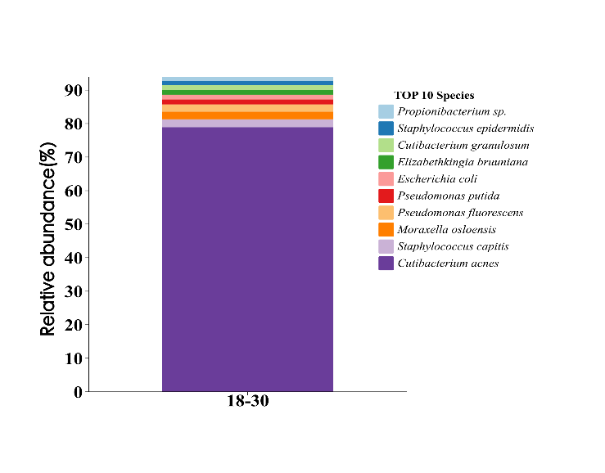
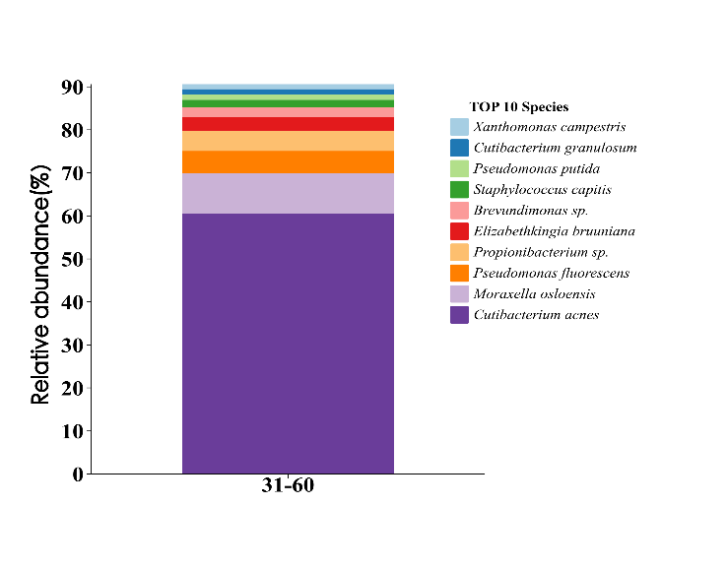
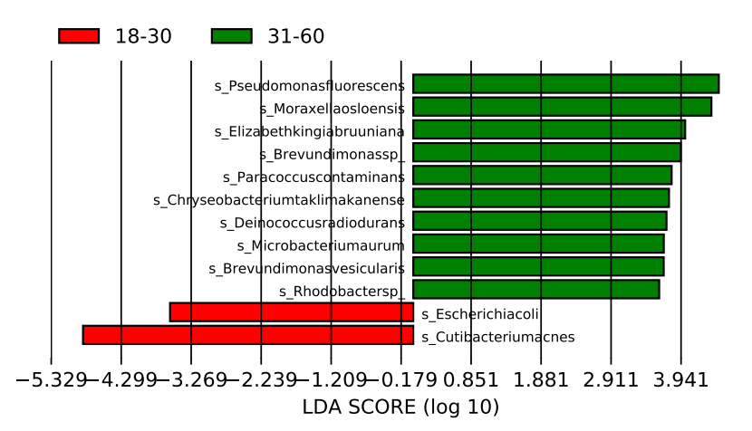
Metagenomic Biomarker Analysis Demonstrates Higher Abundance of Cutibacterium and Escherichia Associated with Pre-Aging Group
Cutibacterium sp2
Propionibacterium sp.
Pseudomonas sp2
Cutibacterium sp1
Staphylococcus sp1
Lactobacillus sp1
Staphylococcus sp2
Malassezia sp1
Neisseria sp1
Microbacterium sp1
Moraxella sp1
Deinococcus sp1
Elizabethkingia sp1
Ralstonia sp1
Pseudomonas sp1
Brevundimonas sp.
Brevundimonas sp1
Serratia sp1
Kocuria sp1
Micrococcus sp1
Chryseobacterium sp1
Paracoccus sp1
Rhodobacter sp1
Escherichia sp1
Xanthomonas sp1
Propionibacterium sp.
Staphylococcus sp1
Cutibacterium sp1
Elizabethkingia sp1
Escherichia sp1
Pseudomonas sp1
Pseudomonas sp2
Moraxella sp1
Staphylococcus sp2
Cutibacterium sp2
Xanthomonas sp1
Cutibacterium sp1
Pseudomonas sp1
Staphylococcus sp2
Brevundimonas sp.
Elizabethkingia sp1
Propionibacterium sp.
Pseudomonas sp2
Moraxella sp1
Cutibacterium sp2
Figure 1. Skin microbial diversity in pre-aging and aging group
Figure 2. Heat map of microbial species abundance at different ages (all age groups)
Pseudomonas sp2
Moraxella sp1
Elizabethkingia sp1
Brevundimonas sp.
Paracoccus sp1
Chryseobacterium sp1
Deinococcus sp1
Microbacterium sp1
Brevundimonas sp1
Rhodobacter sp1
The microbial composition of the pre-aging group (18-30y) is notably distinct from the older age group (31-60y) (Figure 1). In the younger subjects, the microbiota is dominated by Cutibacterium, Staphylococcus, and Moraxella. Whereas in older subjects, there is an observable reduction of Cutibacterium and Staphylococcus, with an enrichment of Moraxella and Pseudomonas.
Cutibacterium is predominantly detected regardless of age group (Figure 2) although larger proportion of the younger subjects were enriched with Cutibacterium than the older age group.
Difference analysis demonstrated statistically significant and different microbial biomarkers between the two age groups (Figure 3). A higher prevalence of Cutibacterium and Escherichia associated with the pre-aging group, while aging group is enriched with Pseudomonas and Moraxella. This finding is aligned with previous studies, suggesting a mutualistic relationship between humans and Escherichia². It is imperative to investigate the specific subtypes of Escherichia present on the skin and to understand the potential transient nature of prevalence and investigate the higher occurrence in younger skin in future study.
Escherichia sp1
Cutibacterium sp2
Figure 3. Enriched microbial taxa in different age groups
2. Hudault, S., et al. Gut. (2001)
Notes:
Difference analysis demonstrated statistically significant and different microbial biomarkers between the two age groups (Figure 3). A higher prevalence of C. acnes and E. coli associated with the pre-aging group, while aging group is enriched with P. fluorescens and M. osloensis. This finding is consistent with the historical research that E. coli has a mutualistic biological relationship with humans[1]. But which sub-species of E. coli is in the skin and why it is more prevalence in younger skin need to be explored in further study. (Figure 3).

Slide 25
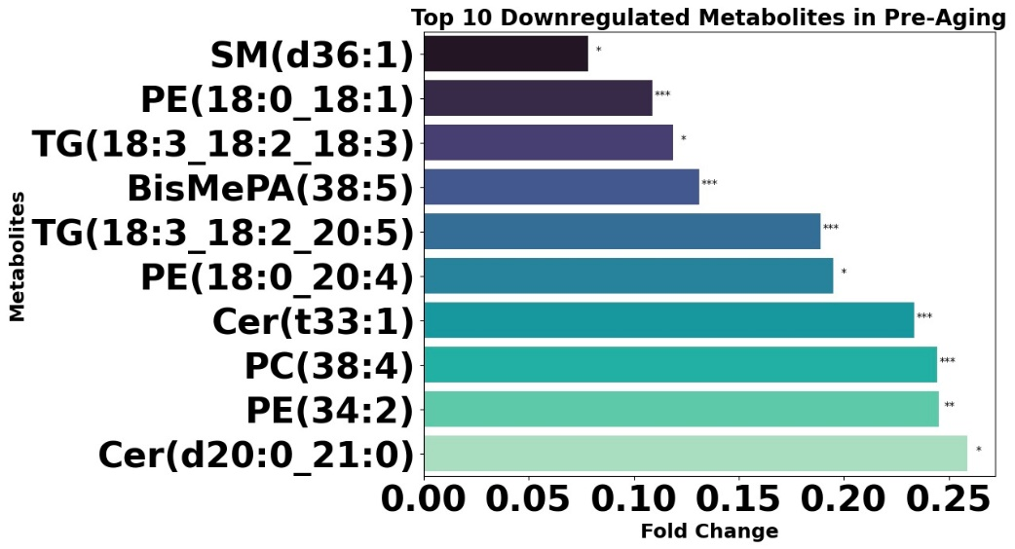
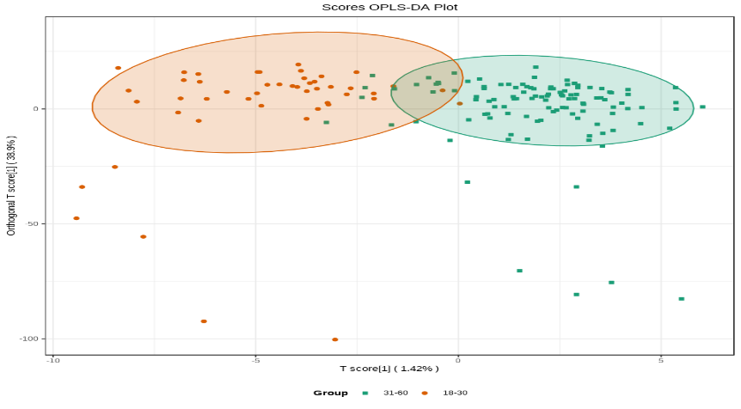
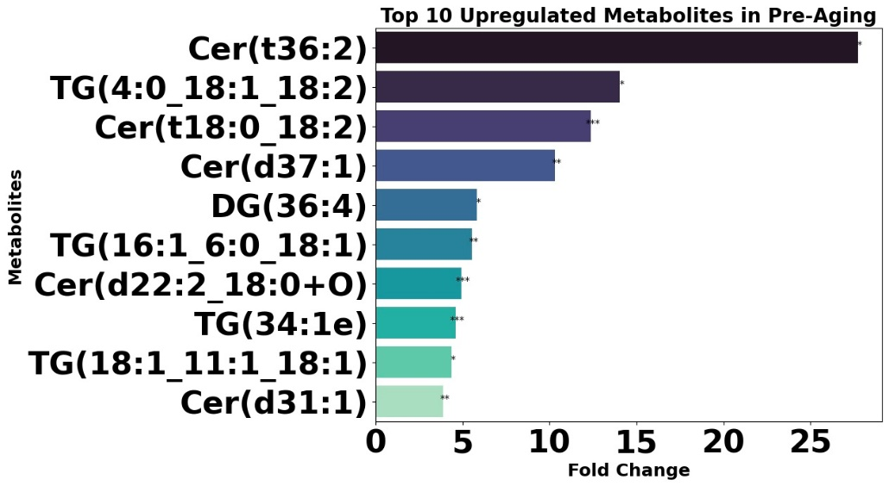
Age-related Alterations in Skin Surface Lipids - Increased Levels of Ceramides and Triglycerides Observed in Pre-aging Group
The relative composition of the skin lipids isolated from both age groups was dominated by mainly triglycerides (TG), ceramides (Cer), and diglycerides (DG).
Differential analysis shows the clustering of lipid metabolites isolated from the pre-aging group to be significantly distinct from the aging group (Figure 4).
57 out of 1117 small lipid molecules were found to be significantly associated with pre-aging group. Specifically, Cer(t36:2), TG(4:0_ 18:1_18:2) and Cer(t18:0_18:2) were identified to be potential lipid biomarkers for pre-aging group (Figure 5). Additionally, SM(d36:1) was found to be significantly depleted in the pre-aging group.
Orthogcnal T score
T score
18-30
31-60
Figure 4. Differential analysis for lipid biomarkers in two different age groups
TG: Triglycerides
CER: Ceramides
DG: Diglycerides
PC: Phosphatidylcholines
SM: Sphingomyelin
BisMePA: Bis(monoacylglycero)phosphate
PE: Phosphoethanolamine
Figure 5. Shift in cutaneous lipid composition between the pre-aging group and aging group. (Fold-change of pre-aging group with respect to aging group)
Notes:
Meckfessel MH, Brandt S. The structure, function, and importance of ceramides in skin and their use as therapeutic agents in skin-care products. J Am Acad Dermatol. 2014 Jul;71(1):177-84. doi: 10.1016/j.jaad.2014.01.891. Epub 2014 Mar 20. PMID: 24656726.

Slide 26
Conclusions
Younger individuals showed a higher prevalence of Escherichia and Cutibacterium, which may be related to the sebum excretion rate that we discovered in the previous study³.
Out of the 1117 lipids analyzed, a total of 57 small lipid molecules were found to have a significant association with chronological age. Cer(t36:2), TG(4:0_ 18:1_18:2) and Cer(t18:0_18:2) were significantly higher and SM(d36:1) was found to be significantly depleted in the younger age group, suggesting that age-related alterations in lipid metabolism and enzymes, can lead to disparate lipid profiles between pre-aging and aging skin.
We have drawn the characteristic maps of skin microbiome and metabolomics through data analysis. Our data revealed the differences and progression of the skin microbiome and metabolomics can change with aging. These findings lay the groundwork for personalized anti-aging interventions specifically targeting the pre-aging phase.
3. Wei, Q., et al. Front. in Microbiol. (2022)

